Slide 1
Scheduling Techniques for GPU Architectures with Processing-In-Memory Capabilities
Conference : PACT’2016
Author : Ashutosh Pattnaik Xulong Tang Adwait Jog,Onur Mutlu
Research unit : Pennsylvania State University,Carnegie Mellon University……

Slide 2
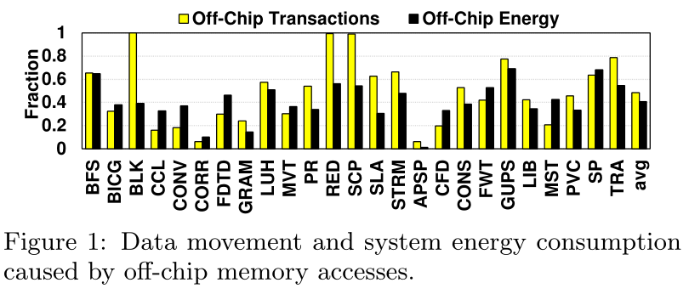
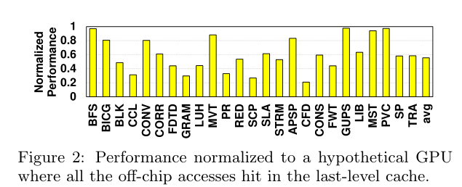
Research work—Background
PIM can greatly alleviate the performance and energy penalties of data transfers from/to main memory.
GPU architectures and applications, where main memory bandwidth is a critical bottleneck, can benefit from the use of PIM.

Slide 3
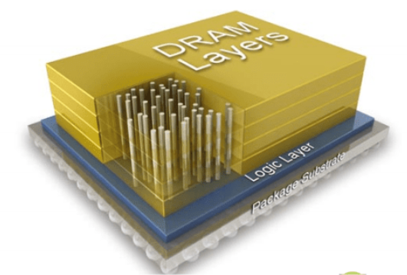
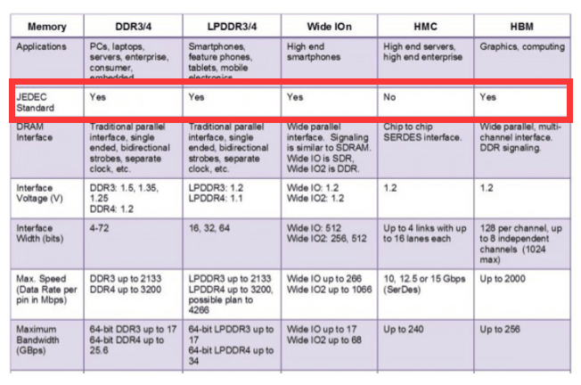

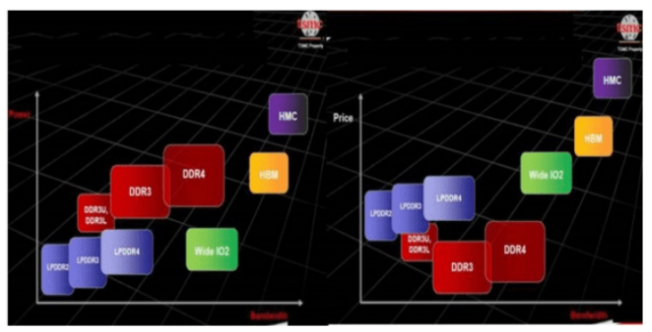
Research work—HBM vs HMC
Power consumption & Price & JEDEC Standard.
JEDEC-Joint Electron Device Engineering Council.

Slide 4
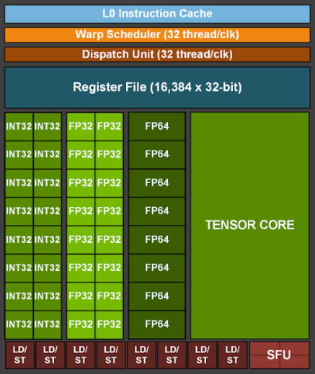
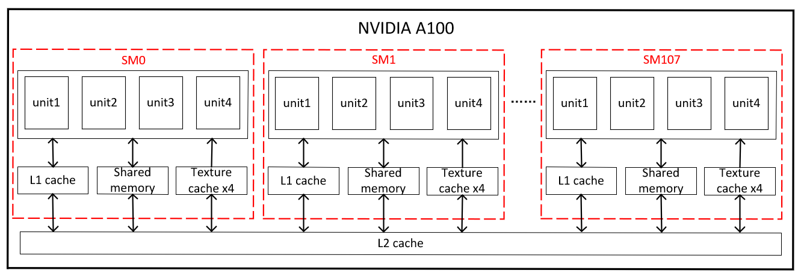
Research work—GPU
7 GPCs, 7 or 8 TPCs/GPC, 2 SMs/TPC, up to 16 SMs/GPC, 108 SMs.
64 FP32 CUDA Cores/SM, 6912 FP32 CUDA Cores per GPU.
4 third-generation Tensor Cores/SM, 432 third-generation Tensor Cores per GPU.
64KB register file per unit.

Slide 5
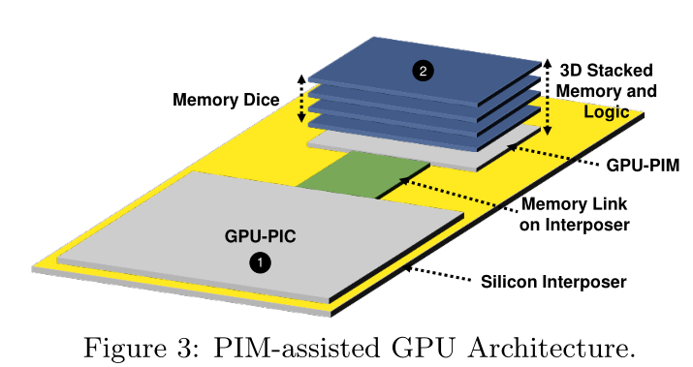
Research work—Problem & Motivation
GPU-PIC and GPU-PIM architectures are quite different in terms of their ability to cater to applications with varying computation and memory demands.
Offloading a compute-bound GPGPU application onto GPU-PIC.
Offloading a memory-bound GPGPU application onto GPU-PIM.
There are many challenges in designing an offloading strategy to maximize overall application performance and energy efficiency by appropriately partitioning and scheduling an application across GPU-PIC and GPU-PIM.

Slide 6
Research work—Solution

Slide 7
Research work—Challenge
How to automatically identify the code segments to be offloaded to the GPU cores in memory?
What the granularity of the code segment that is offloaded to GPU-PIM should be?
How to determine which code segments benefit from being executed on GPU-PIM?
How to concurrently schedule multiple kernels on the main GPU and the cores in memory?
How to efficiently distribute work between the main GPU and the PIM engine to maximize system performance, while executing each code segment on its preferred cores as much as possible?

Slide 8
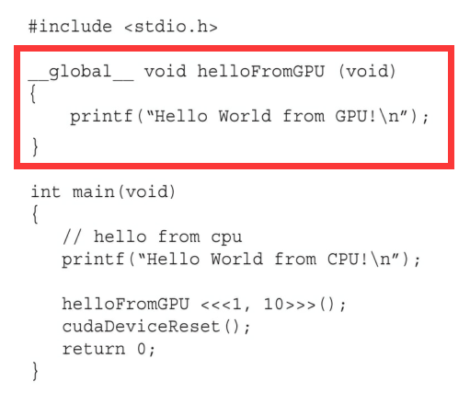
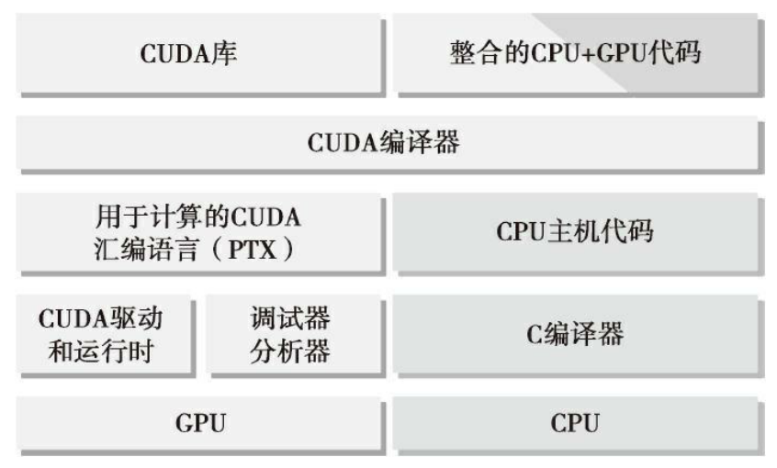
Research work—Technique
What the granularity of the code segment that is offloaded to GPU-PIM should be?
Kernel granularity.
CPU offloads computation to the GPU at the kernel granularity, maintaining the same granularity for PIM execution enables low-overhead computation offloading from the CPU to both GPU-PIC and GPU-PIM.
Kernels are defined by programmer.

Slide 9
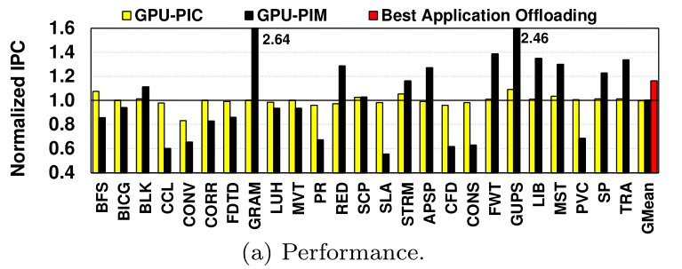
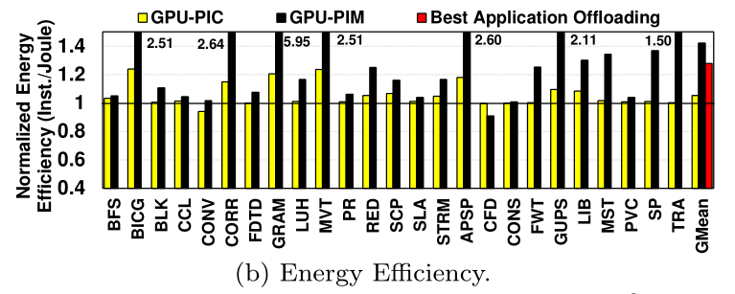
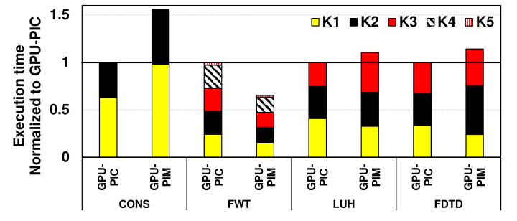
Research work—Technique
Kernel Offloading Mechanism.

Slide 10
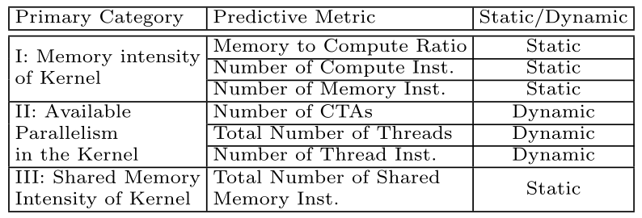
Research work—Technique
Kernel Offloading Mechanism.
An prediction model to enable a run time mechanism for kernel offloading.
Metrics-character the kernel affinity to GPU-PIC or GPU-PIM.
(1) Memory intensity.
a. Memory to Compute Ratio : memory-to-compute-ratio of the instruction mix executed by that particular kernel.
b. Number of Compute Inst.
c. Number of Memory Inst.
(2) Parallelism.
(3) Shared memory intensity.

Slide 11
Research work—Technique
Kernel Offloading Mechanism.
An prediction model to enable a run time mechanism for kernel offloading.
Metrics-character the kernel affinity to GPU-PIC or GPU-PIM.
(1) Memory intensity.
(2) Parallelism.
a. Number of CATs - the number of cooperative thread arrays (CTAs) (also called work groups or thread
blocks) as a measure of the parallelism in the kernel.
b. Total Number of Threads.
c. Number of Thread Inst.
(3) Shared memory intensity.
a. Total Number of Shared Memory Inst.

Slide 12
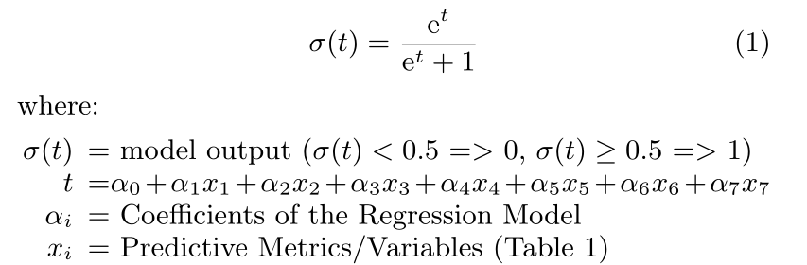

Research work—Technique
Kernel Offloading Mechanism.
An prediction model to enable a run time mechanism for kernel offloading.
Regression Model for Affinity Prediction.
(1) $σ\left(t\right)=0 for GPU−PIC$
(2)$σ\left(t\right)=1 for GPU−PIM$
Train set and test set.
(1) Randomly sample 60%(15) of the 25 GPGPU applications which consist 82 unique kernels as train set.
(2) Using 40%(10) of the 25 GPGPU applications which consist 42 unique kernels as test set.
Accuracy : 83%.

Slide 13
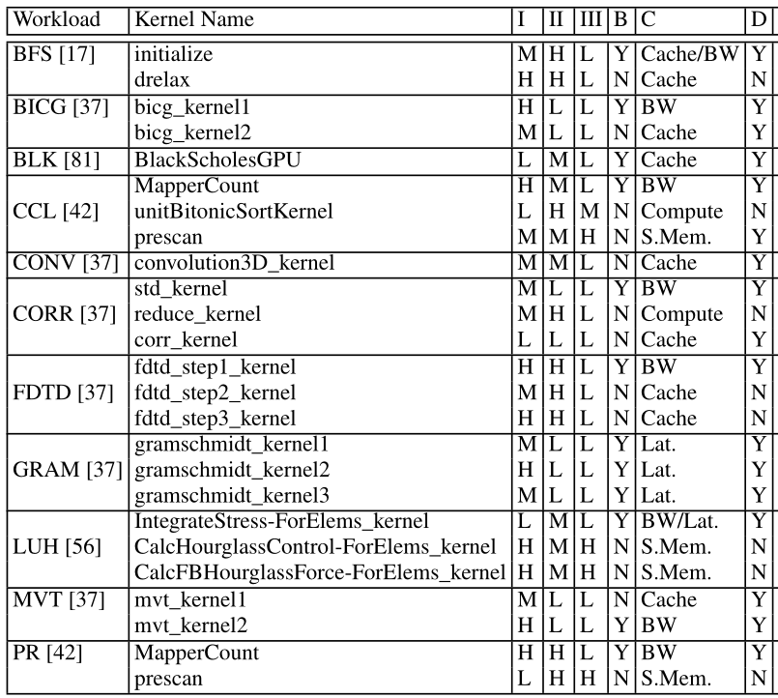
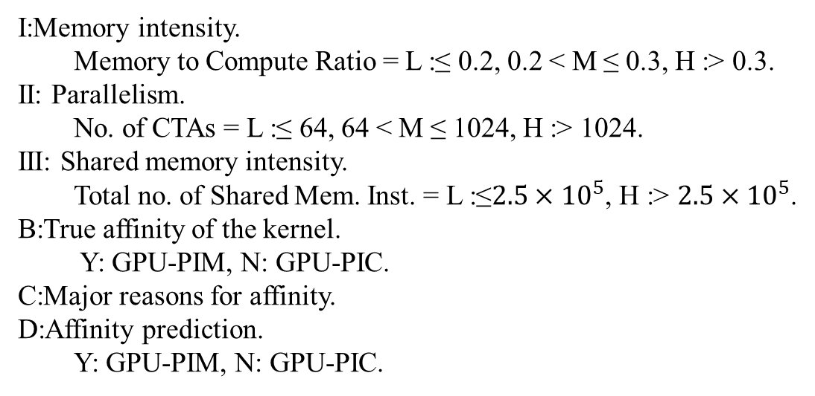
Research work—Technique
Kernel Offloading Mechanism.
An prediction model to enable a run time mechanism for kernel offloading.
Regression Model for Affinity Prediction.
I:Memory intensity.
Memory to Compute Ratio = L :≤ 0.2, 0.2 < M ≤ 0.3, H :> 0.3.
II: Parallelism.
No. of CTAs = L :≤ 64, 64 < M ≤ 1024, H :> 1024.
III: Shared memory intensity.
Total no. of Shared Mem. Inst. = L :≤$2.5×{10}^{5}$, H :> $2.5×{10}^{5}$.
B:True affinity of the kernel.
Y: GPU-PIM, N: GPU-PIC.
C:Major reasons for affinity.
D:Affinity prediction.
Y: GPU-PIM, N: GPU-PIC.

Slide 14
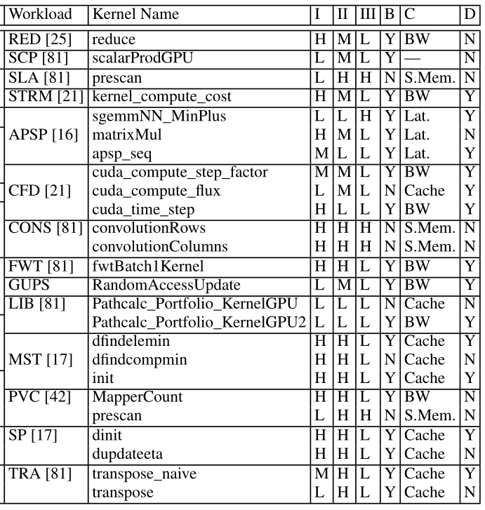
Research work—Technique
Kernel Offloading Mechanism
An prediction model to enable a run time mechanism for kernel offloading.
Regression Model for Affinity Prediction.
I:Memory intensity.
Memory to Compute Ratio = L :≤ 0.2, 0.2 < M ≤ 0.3, H :> 0.3.
II: Parallelism.
No. of CTAs = L :≤ 64, 64 < M ≤ 1024, H :> 1024.
III: Shared memory intensity.
Total no. of Shared Mem. Inst. = L :≤$2.5×{10}^{5}$, H :> $2.5×{10}^{5}$.
B:True affinity of the kernel.
Y: GPU-PIM, N: GPU-PIC.
C:Major reasons for affinity.
D:Affinity prediction.
Y: GPU-PIM, N: GPU-PIC.

Slide 15
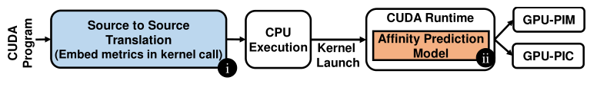
Research work—Technique
Kernel Offloading Mechanism.
An prediction model to enable a run time mechanism for kernel offloading.
Implementation.
Source to Source Translation : Computing the values of static metrics.
CUDA Runtime : Getting the dynamic metrics.

Slide 16
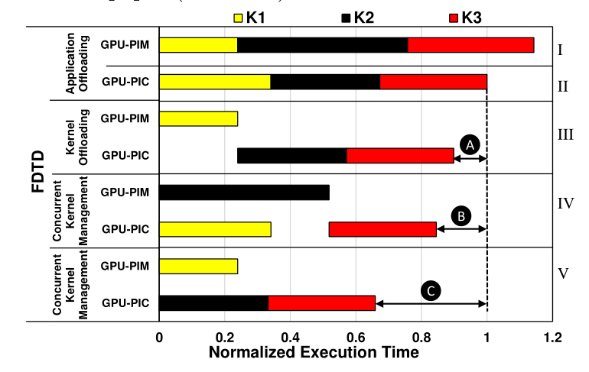
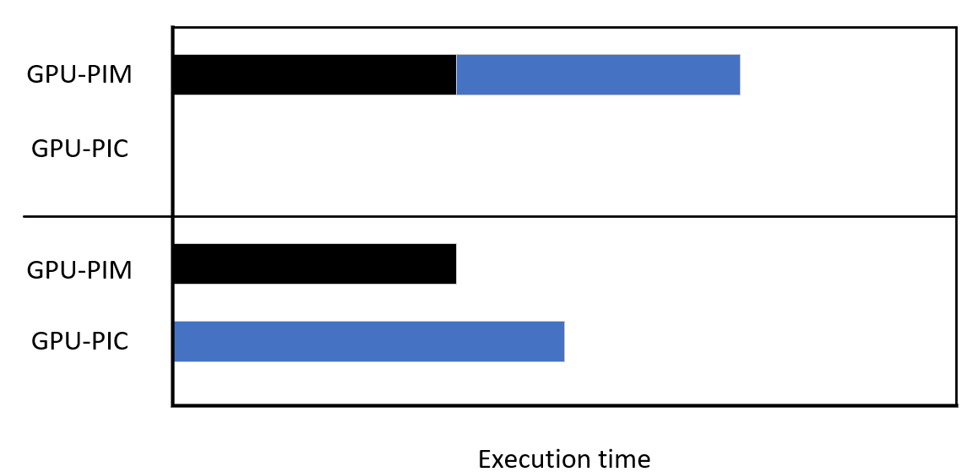
Research work—Technique
Concurrent kernel management.
Benefit.
Three key pieces of information.
Kernel-level dependence information to identify independent kernels.
Affinity of each kernel.
Execution time prediction for each kernel.

Slide 17
Research work—Technique
Concurrent kernel management.
Kernel-level dependence information to identify independent kernels.
Obtaining the dependence graph of an application for a given input by profiling the application’s execution to determine the correct and complete set of read-after-write (RAW) dependencies across the kernels.
Architecture Affinity Information.
Execution Time Information.

Slide 18
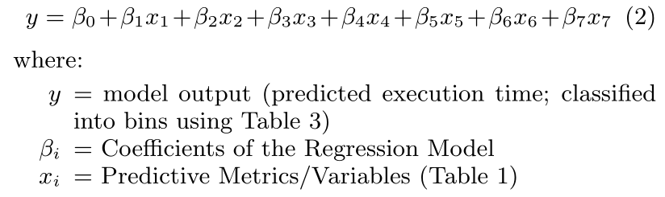
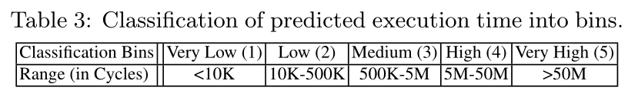
Research work—Technique
Concurrent kernel management.
Execution Time Prediction Model.
Linear regression model.
Accuracy : 77% and 80% on the test set for GPU-PIC and GPU-PIM.

Slide 19
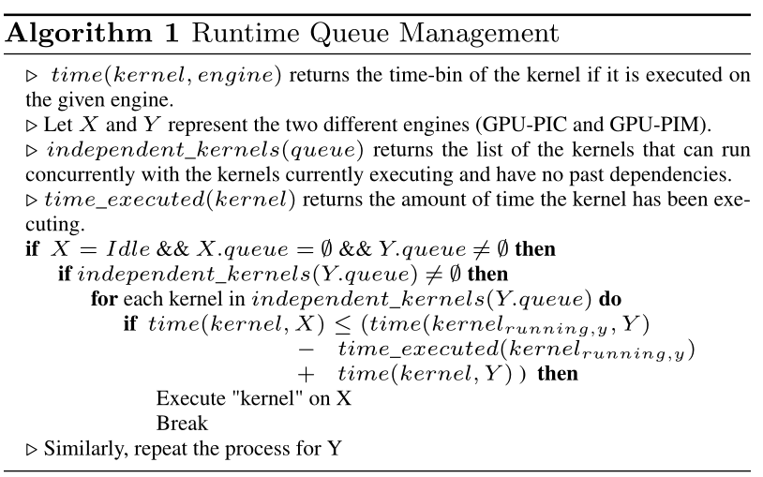
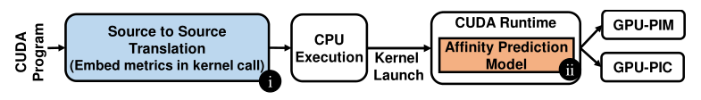
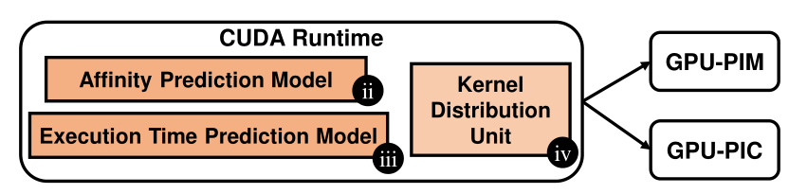
Research work—Technique
Concurrent kernel management.
Algorithm and Implementation.

Slide 20
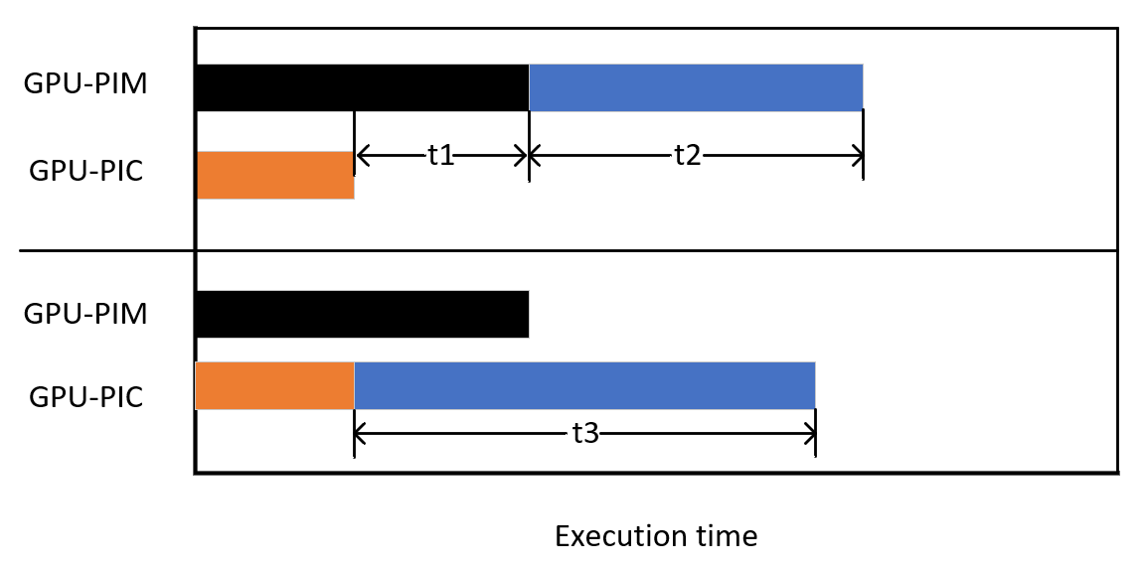
Research work—Technique
Concurrent kernel management.
Algorithm and Implementation.
t1+t2>t3 then offload the kernel to another processing unit.

Slide 21
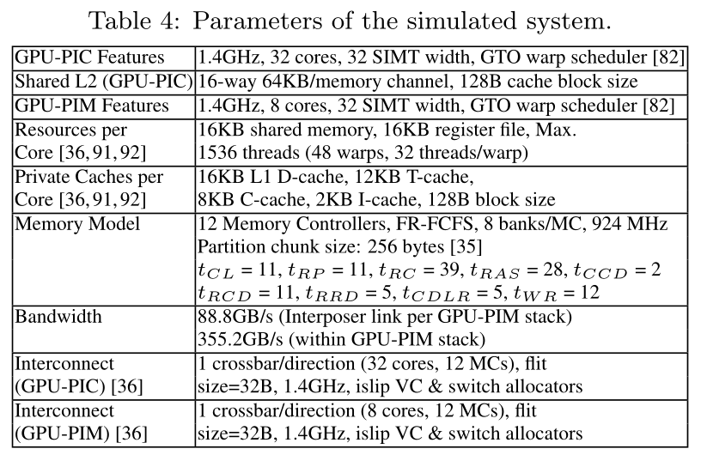
Research work—Evaluation
Methodology.
Algorithm and Implementation.
Simulator : GPGPU-Sim.

Slide 22
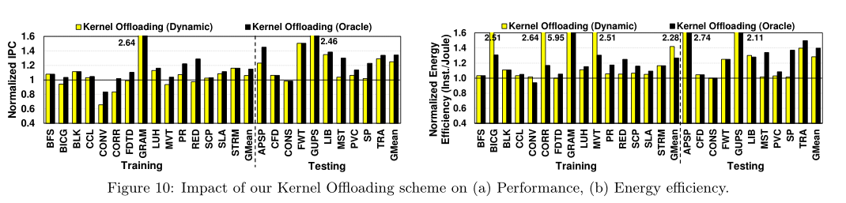
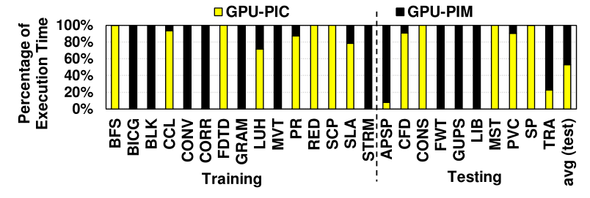
Research work—Evaluation
Effects of Kernel offloading.
Increasing the performance and energy efficiency of the testing set applications by 25% and 28%.
Percentage of execution time of GPU-PIM and GPU-PIC.
Increasing the performance and energy efficiency of the testing set applications by 25% and 28%.

Slide 23
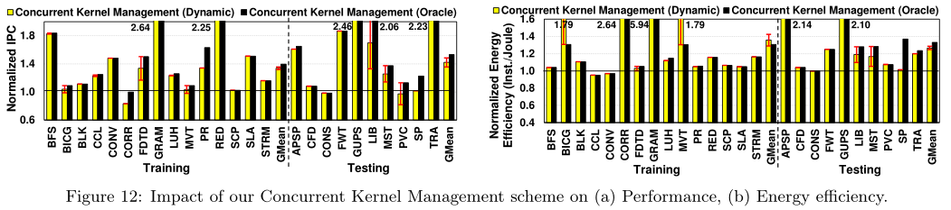
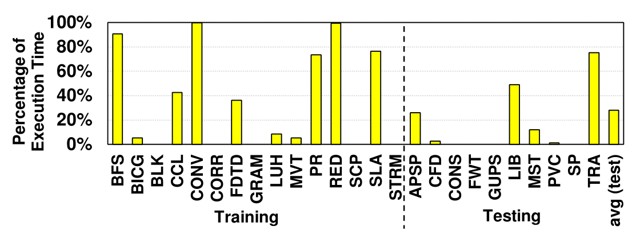

Research work—Evaluation
Effects of Concurrent Kernel Management.
Increasing the performance and energy efficiency of the testing set applications by 42%$±4\% and\text{ 27}\text{\%}±2\%.$
The execution time when kernels are concurrently running on GPU-PIM and GPU-PIC.

